Slide 1
Team name, Project title, name of mentor
List of students

Slide 2
State of the Art
TITLE OF THE PROJECT
1. This powerpoint presentation should contain details of what has happened in the world / country in the past 5-10 years related to your project and the technologies associated with your technologies
2. Also trends of 2024
3. Minimum 2 Slides

Slide 3
SAMPLE

Slide 4
State of the Art
Customised UI/UX Design

Slide 5

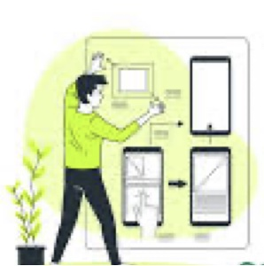
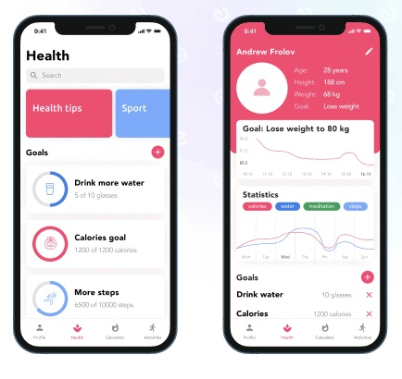
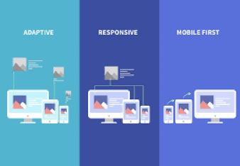
Growth of UI/UX designs/technology in the past decade
In the early 2010s, UX design was still adapting to the introduction and rising popularity of widespread smartphone and tablet use. Mobile devices were becoming part of a company’s UX strategy ten years ago, but mobile was still low on the priority list.
In 2011, user experience designers were more focused on creating analytics-backed, behavior-driven features and functions than they were catering to mobile devices. Social media icons, personalized content, and a quicker, more efficient experience were top-of-mind tactics.
UX Design trend in the past 10 years includes:Bold primary colors, Focus on minimalism, Gradients with minimal gloss, Textured and patterned backgrounds, Magazine/newspaper layouts
Responsive and Adaptive Design: adaptive design might be more appropriate for existing complex websites, and responsive design is ideal for new businesses. Responsive design is more budget-friendly than adaptive design, but adaptive design is better for a more targeted user experience.

Slide 6
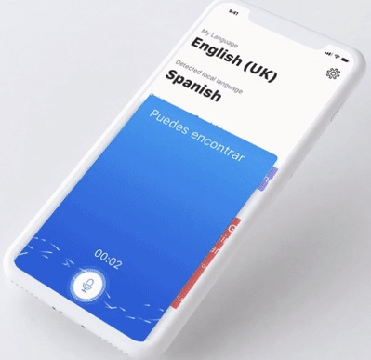
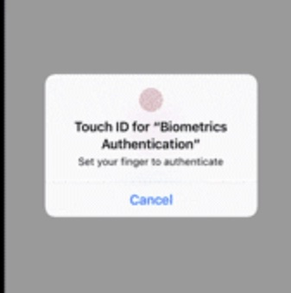

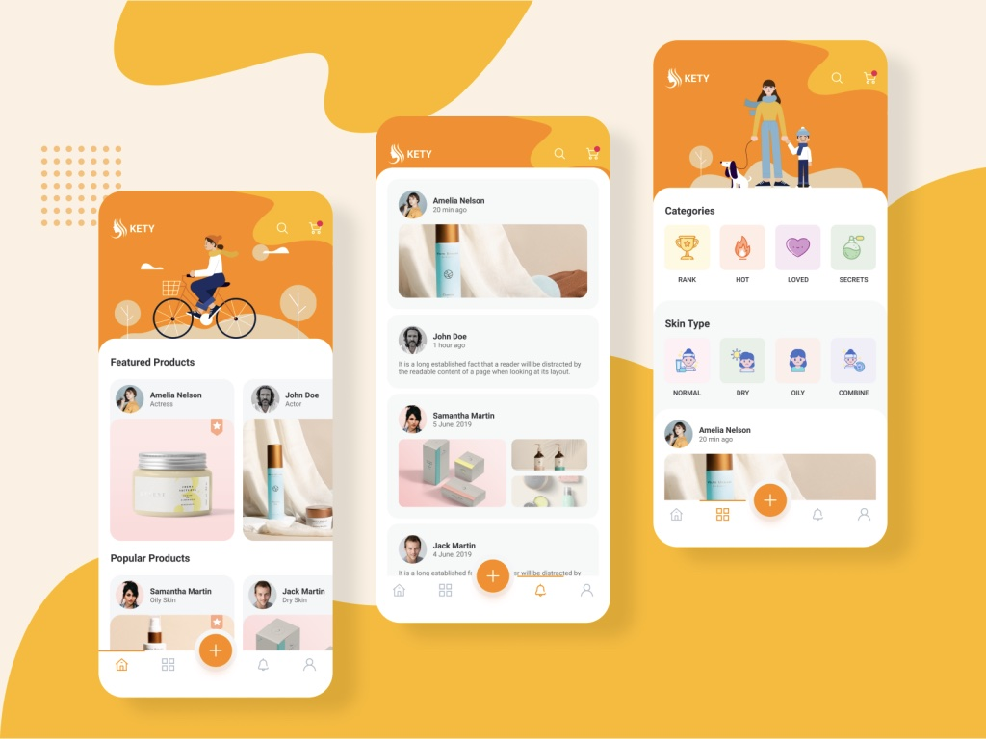
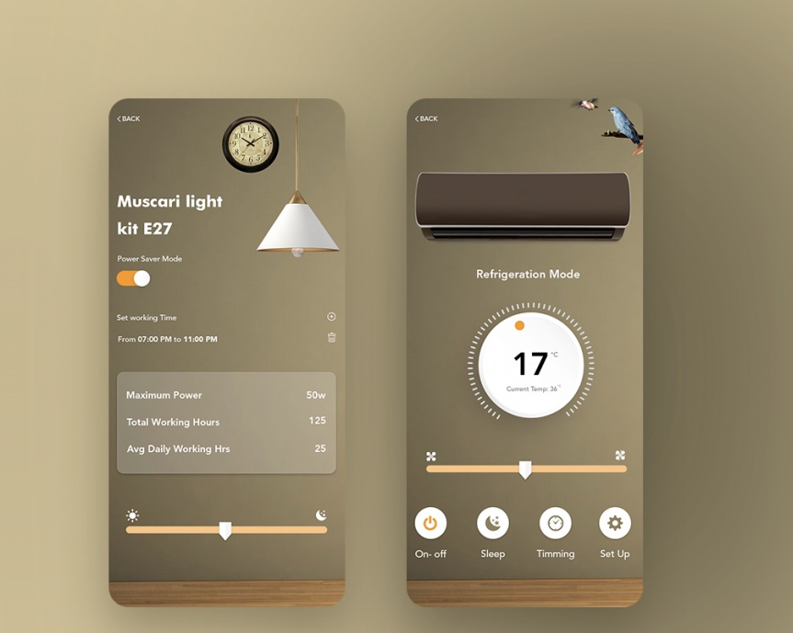
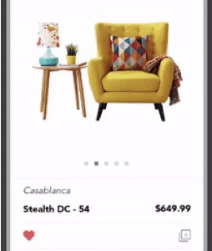
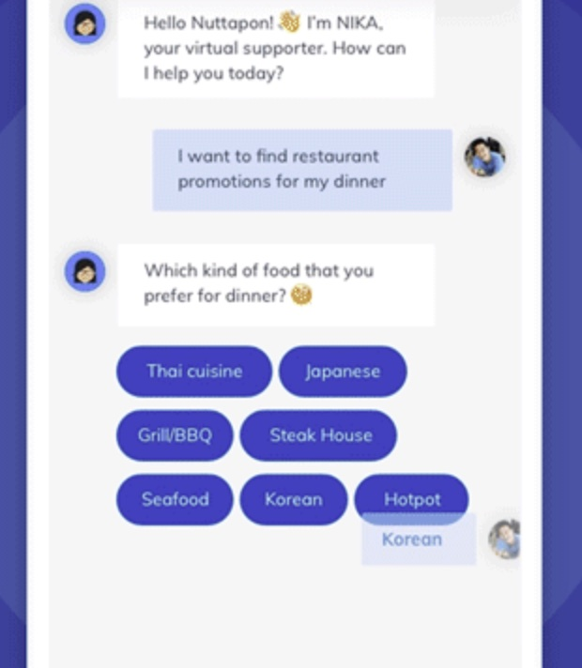
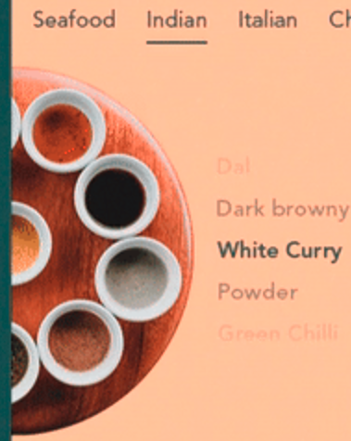
Mobile UI UX Design Trends for 2024
Improved Personalization
Rounded Corners
Convenient Voice Interaction
Password-less Login
Advanced Animation
Gradient
AR/VR
Chatbots UI Design

